Slide 1

Robotic Process Automation
Teoh Teik Toe
ITOM/NBS
ttteoh@ntu.edu.sg
97905202

Slide 2
Recording: https://1drv.ms/v/s!Aik2a4x7tvLyi6xHOOZ2Mrv7Sa1LBA?e=fLNNyf
Pg 22,25,29,41

Slide 3
Youtube:
RPA: https://youtu.be/9URSbTOE4YI?si=MQli4rNKDdE1egbs
UiPath https://youtu.be/S8vyutaQgZ8?si=RX470cHY4eHFhqSg https://youtu.be/5i5CJsFnEj0?si=JoM1o_Bm6RFpWiHG https://youtu.be/5i5CJsFnEj0?si=k2QEKuaKPcbAV5d3 https://youtu.be/5i5CJsFnEj0?si=Bqv7r0ONIdnYp958 https://youtu.be/IejDU8U63mY?si=J1sREYIMo2wjiVm- login https://youtu.be/pYdnE6dc_Bk?si=erejKRgnD2DY3Q6t
Recording: https://1drv.ms/v/s!Aik2a4x7tvLyi6xHOOZ2Mrv7Sa1LBA?e=fLNNyf

Slide 4

Objective
To know about Robotic Process Automation and able to use UiPath to automate processes
To create a simple automated process using UiPath
To develop RPA programming skill

Slide 5
Agenda
Intro to RPA
UiPath
Exercise
Discussion
Review
Examples of RPA:https://mindmajix.com/30-rpa-examples

Slide 6
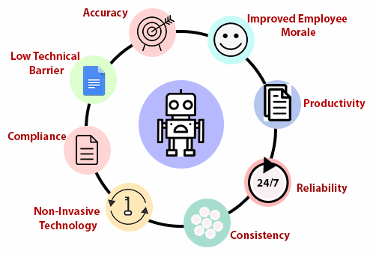
Why RPA

Slide 7
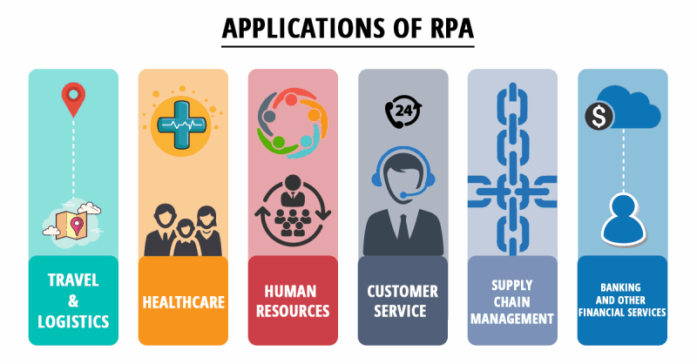

Slide 8


Slide 9
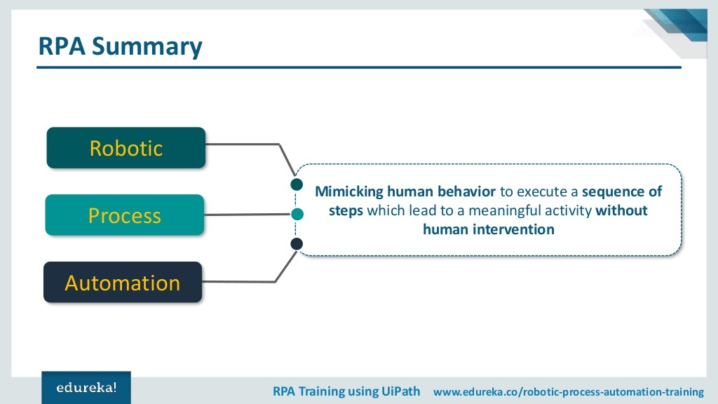

Slide 10
Processes can be automated with RPA
Word
Email
Excel
Browser
Other application such as Calculator

Slide 11
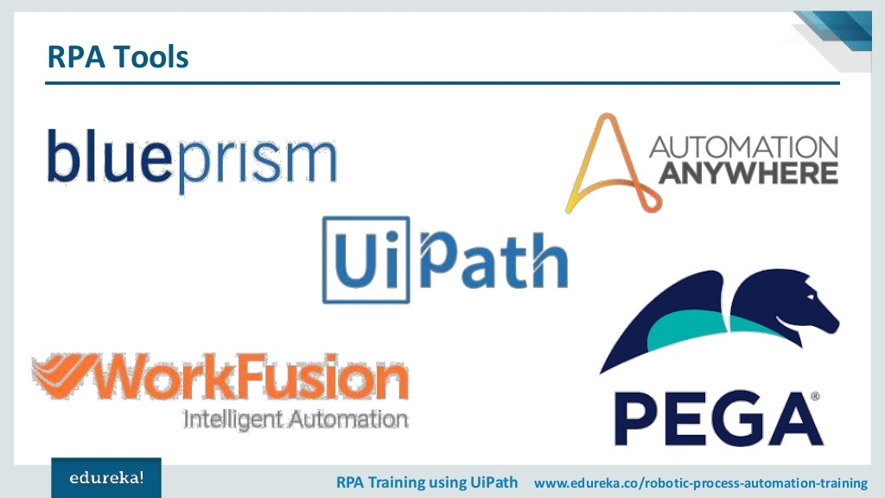

Slide 12
RPA Studio Web (UiPath) https://cloud.uipath.com/

Slide 13
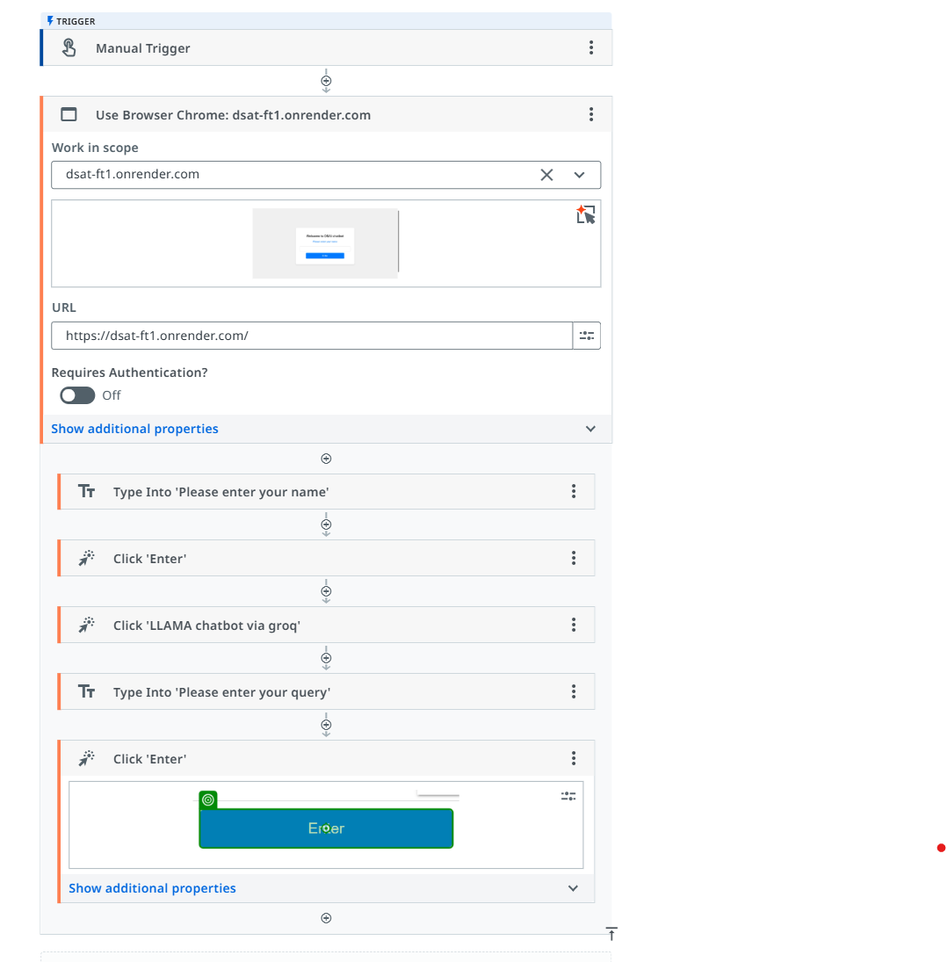
Browser, click and type into

